Slide 1
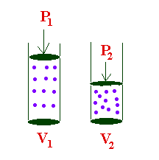
Boyle’s Law
P₁ = Low ↓ P₂ = High ↑
V₁ = High ↑ V₂ = Low ↓

Slide 2
Boyle’s Law
The volume of a gas is inversely proportional to its pressure if the temperature and number of particles is constant
T = C V ↑ P ↓
T = C V ↓ P ↑

Slide 3
Boyle’s Law
Saying – Beat Perk Valley,
sometimes you win & sometimes you loose
Boyles = Pressure Volume
↑ ↓
or
↓ ↑

Slide 4

Charles’s Law
5° K
35° K
T₁ = Low ↓ T₂ = High ↑
V₁ = Low ↓ V₂ = High ↑

Slide 5
Charles’s Law
The volume of a gas is directly proportional to its temperature in Kelvins if the pressure and the number of particles of the gas are constant.
T ↑ V ↑ P = C
T ↓ V ↓ P = C

Slide 6
Charles’s Law
Saying – C “See” T V “Television”
Charles = Temperature Volume
Eyes Watching - ↑↑
or
Image from TV - ↓↓

Slide 7
